Slide 1
Instructions for use
Information only. Delete this slide.
Templates
Please use an official EAUC title and end slide to start and close your presentation. You find templates below or by going to Insert and New slide.
You can add your organisation’s branded slides in between.
Alternatively, you can use the EAUC templates available if you wish. Go to Insert and New slide to see templates.
Whatever template you use, please review and follow the accessibility instructions in the next few slides.

Slide 2
Accessibility (1 of 4)
Information only. Delete this slide.
Text
For headings and body text, please use a minimum text size of 24pt.
Please use one of these fonts:
  Aptos
  Arial
  Helvetica
  Tahoma
  Verdana
Ensure there is sufficient colour contrast between the text colour and background colour.
More information:
  Make your PowerPoint presentations accessible to people with disabilities.
  Colour contrast checker

Slide 3
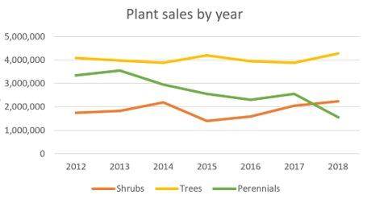
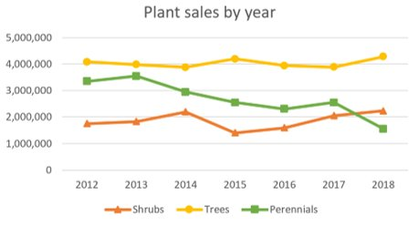
Accessibility (2 of 4)
Information only. Delete this slide.
Images, graphs and charts
Include alternative text (alt text) on all visuals.
Ensure colour is not used as the only way to convey meaning.
  For example, when explaining the graph on the right, avoid saying “the orange line shows..” and instead say “the line with the triangles shows..”.
Figure 1:
This graph would be difficult to read for people with colour deficiencies.
Figure 2:
This graph is better as shapes have been used to differentiate the lines.
Source: Ability Net

Slide 4
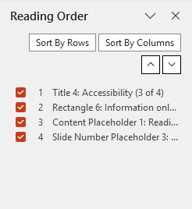
Accessibility (3 of 4)
Information only. Delete this slide.
Reading order
Make sure slide contents can be read in the order you intend by screen readers.
Select Review and Reading Order Pane to check this.
More information: How to use the Accessibility Checker to find slides that have possible problems with reading order.

Slide 5
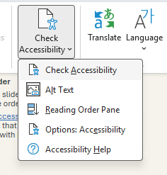
Accessibility (4 of 4)
Information only. Delete this slide.
Use the accessibility checker
Before sending EAUC your presentation, select the Review tab and select Check Accessibility to open the accessibility pane and follow the recommendations.
You can find more information on the Microsoft website: How to use the accessibility checker.
Send your presentation to us as a PowerPoint file to preserve the accessibility features.

Slide 13
How to contact us
To continue to facilitate peer-to-peer learning after the event, we will upload your presentation to the resource hub on the EAUC website.
Please therefore include your work contact details on this slide if you’re happy to be contacted. Do not include any personal information that you do not want published online.
If you have any issues with us sharing your presentation beyond the event, for example, due to copyright reasons, please let us know as soon as possible: info@eauc.org.uk

