Slide 1
How to make great and accessible slides
for events and conferences
March 2026

Slide 2

Contents
Purpose
Part 1: Planning your breakout session: creating presentations
Part 2: During the breakout session
Part 3: Post breakout session

Slide 3

Introduction
There are more than 4.4 million disabled people in work (Source: Ability Net).
People may experience more than one condition or disability at the same time.
We have a legal duty to ensure that our services are accessible to everyone and that we do not discriminate against people with disabilities.

Slide 4
Aims of this resource
These slides outline the key things you should do to ensure your session is accessible to all participants before, during and after the session
It is not a complete list but gives you a starting point
Please check your own institution’s accessibility guidance for further information
We’ll add your slides to the resource hub on the EAUC website after the event
It’s therefore important that your presentation is not only accessible on the day, but could be read by people using screen readers and other assistive technologies afterwards

Slide 5
Part 1: Planning your breakout session

Slide 6
Creating presentations (1 of 6)
Text
For headings and body text, please use a minimum text size of 24pt
Please use one of these fonts:
  Aptos
  Arial
  Helvetica
  Tahoma
  Verdana
Ensure there is sufficient colour contrast between the text colour and background colour. You can check this using a colour contrast checker

Slide 7
Creating presentations (2 of 6)
Hyperlinks
Screen readers often allow users navigate pages by links
Please ensure hyperlinked text is meaningful on its own. Avoid vague phrases such as “click here” or “on this website”
The links on the right are examples of good practice
More information:
  Make your PowerPoint presentations accessible to people with disabilities.
  Create accessible links in Word.

Slide 8
Creating presentations (3 of 6)
How much information?
Avoid overloading the slides with too much information
As a general rule, aim to use the three times three method: include no more than three messages and supporting ideas per slide
When presenting numerical data, aim to give context and use comparisons to make concepts relatable
For example, the UK universities’ estates alone cover a total area of 6,390 hectares. This equates to a town the size of Guildford, Chesterfield or Stirling.

Slide 9
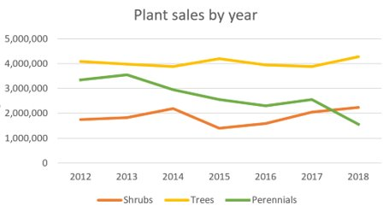
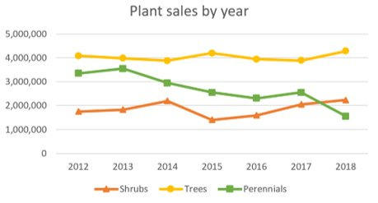
Creating presentations (4 of 6)
Images, graphs and charts
Include alternative text (alt text) on all visuals
Do not rely on colour as the only way to convey meaning
  For example, when explaining the graph on the right, avoid saying “the orange line shows..”
  Instead, you can say “the line with the triangles shows..”.
Limit animations to one per slide
Figure 1:
This graph would be difficult to read for people with colour vision deficiencies.
Figure 2:
This graph is better as shapes have been used to differentiate the lines.
Source: Ability Net

Slide 10
Creating presentations (5 of 6)
Reading order
Make sure slide contents can be read in the order you intend by screen readers
Select Review, Check Accessibility and the Document Structure pane to check this
More information
How to use the Accessibility Checker

Slide 11
Creating presentations (6 of 6)
Use the accessibility checker
Before sending EAUC your presentation, select the Review tab and select Check Accessibility to open the accessibility pane and follow the recommendations
Send your presentation to us as a PowerPoint file to preserve the accessibility features
More information
How to use the Accessibility Checker

Slide 12

Part 2:
During your session

Slide 13
During the session (1 of 4)
General principles for the format of your session
If a delegate has requested additional support, you will be informed of this before your session so we can work with you to make the necessary accommodations
Set expectations early. For example, explain the format of the session, any breaks and how any interaction will work

Slide 14
During the session (2 of 4)
Offer people a range of ways they can participate and digest information.
For example:
  When showing a video, ensure there are subtitles for people who may have hearing difficulties.
  If using QR polls or forms, explain the task, give time to complete it and offer an alternative way to participate for those that may not be digitally confident

Slide 15
During the session (3 of 4)
When delivering your session, please also keep in mind plain, inclusive language and delivery. For example:
  explain any abbreviations or acronyms
  use examples and give context
  speak at a steady pace
  have a clear format for your session: consider a beginning, middle and end

Slide 16
During the session (4 of 4)
Question and answer sessions
Use a microphone whenever provided
Repeat audience questions into the microphone before answering
Welcome one speaker at a time to ask their question. Avoid “shouted from the back” discussions that could exclude people with hearing difficulties
Build in thinking time after questions. A silent count to five can be powerful!
When using flipcharts or whiteboards, read out what you write
Give people different ways to ask questions: verbal or written for example

Slide 17

Part 3: Post breakout session

Slide 18
Share your resources
Share slides in PowerPoint (.ppt) to keep the accessibility features
Use meaningful file names. For example: SessionTitle_SpeakerName_EAUC_2026
For recorded sessions, please provide a transcript where possible
Add your contact details to the end of the presentation
If seeking feedback, keep it short and offer alternative routes. For example, a QR form, email and verbal feedback

Slide 19
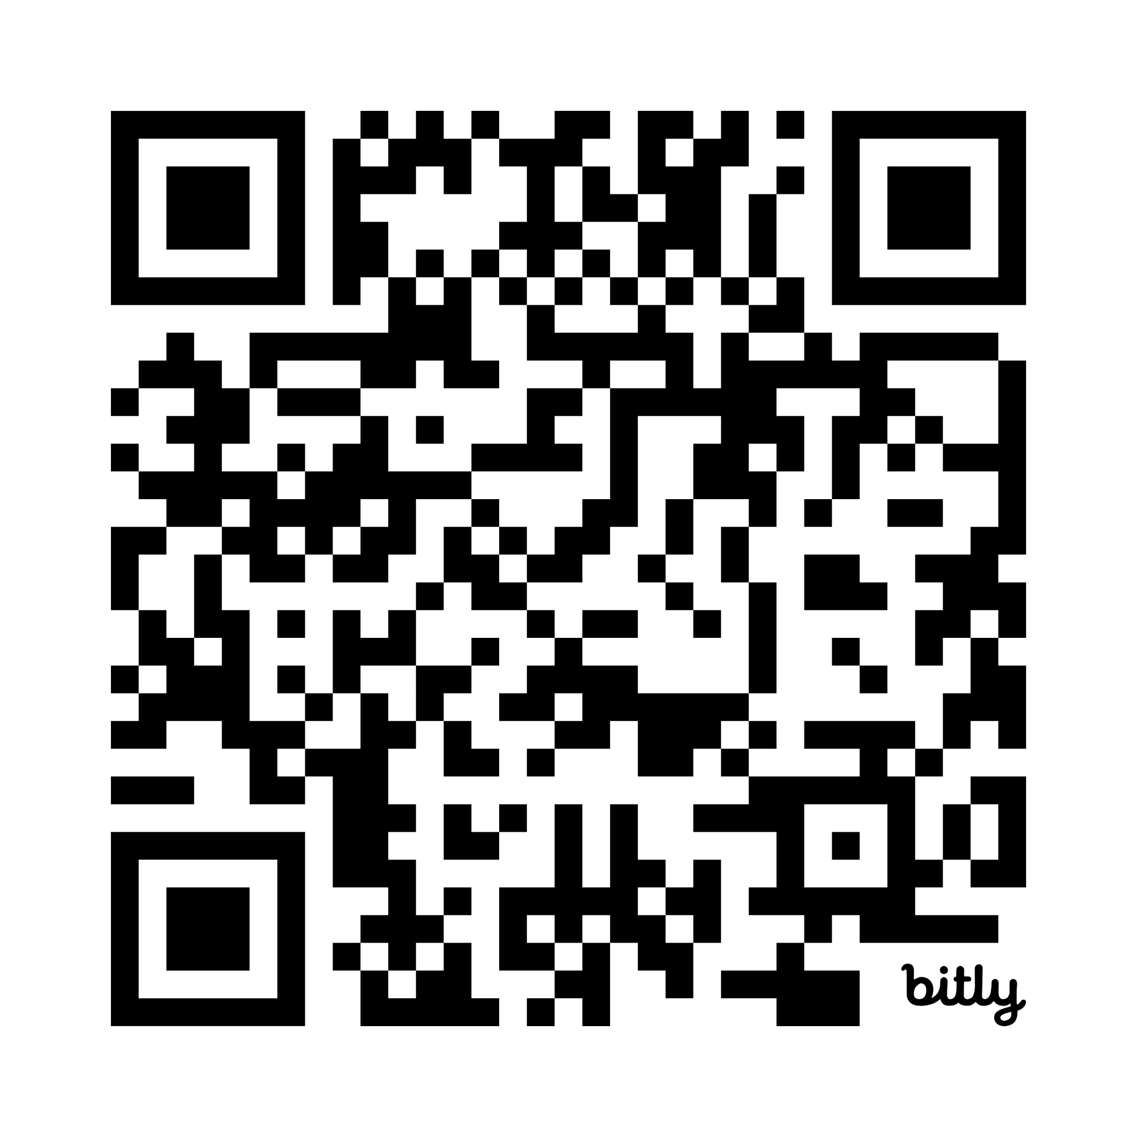
Thank you
Email: info@eauc.org.uk
Tel: +44 (0)1242 714 321
EAUC – The Environmental Association for Universities and Colleges is a charity, no: 1106172 and company limited by guarantee in England & Wales, no: 05183502. ©EAUC. All rights reserved. Although every reasonable effort has been made to ensure that the information contained in this document is accurate, EAUC does not warrant its accuracy and disclaims any liability for its use.

